Slide 1
Basic AngularJs
Tasnim Reza
Git: https://github.com/tasnim-reza/angularjs-class

Slide 2
Agenda
Browser Basic
DOM
What is AngularJs
Demo
Handle a Form using jQuery
Handle a Form using AngularJs

Slide 3
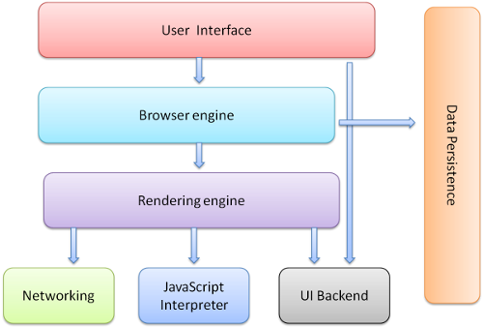
Browser Basic
http://www.html5rocks.com/en/tutorials/internals/howbrowserswork/

Slide 4
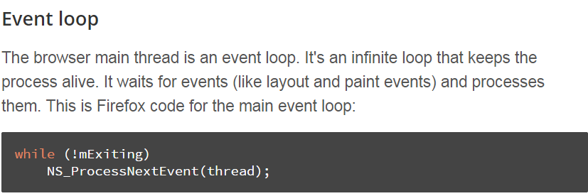
Browser Basic
Rendering Engine
Single threaded
Network operation multiple thread
Event Loop

Slide 5
Browser Basic
JavaScript Engine
V8 - open source, developed by Google in Denmark, part of Google Chrome
Chakra, for Internet Explorer 9^{[16]}
Rhino, Spidermonkey used by Firefox
JavaScriptCore for Apple for Safari

Slide 6
DOM
Document Object Model
Web browsers rely on layout engines to parse HTML into a DOM
It is the object presentation of the HTML document
The root of the tree is the "Document" object.

Slide 7
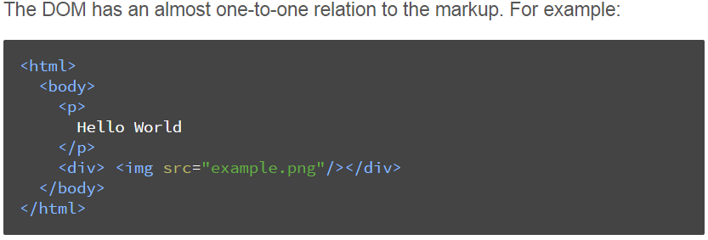
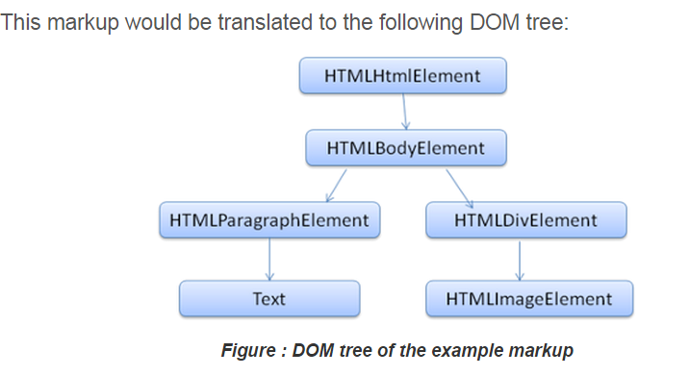
DOM

Slide 8
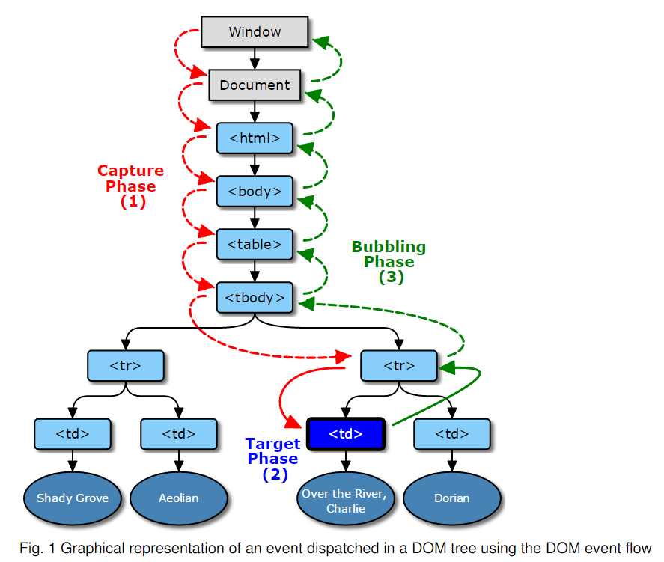
DOM Event
http://www.w3.org/TR/DOM-Level-3-Events/#dom-event-architecture

Slide 9
DOM Event
var e = document.createEvent("Event");
e.initEvent("myevent", false, false);
var target = document.createElement("div");
target.addEventListener("myevent", function () {
throw "Error";
});
target.dispatchEvent(e); // Causes the event listener to throw an exception...
// The previously thrown exception doesn't affect the code that follows:
console.log("Exceptions? No problem");
http://www.w3.org/TR/DOM-Level-3-Events/#dom-event-architecture

Slide 10
What is Angular anyway ?

